Slide 1
Pluricultural aspects in the Companion Volume to the Common European Framework of Reference for Languages: building on pluricultural repertoire
CEFR Companion Volume implementation toolbox
Implémentation du Volume complémentaire du CECR – Boîte d’outils

Slide 2
Building on pluricultural repertoire: the construct of pluricultural competence
Pluriculturality is being able to identify and participate in other cultures, but the construct of pluricultural competence in the Companion Volume is more complex and includes the ability to understand “otherness” to encourage a democratic culture in Europe.
Encouraging the diversity of languages and cultures involves helping learners to construct their linguistic and cultural identity with this positive experience of otherness and also encouraging them to learn by fostering the interaction between different languages and cultures.
Intercultural competence is the ability to experience otherness and cultural diversity and analyse it to derive a benefit, and once acquired, it can help understand otherness and establish cognitive links between past and new experiences of otherness. This leads to questioning the assumptions of your cultural group and environment. (Beacco et al., 2016: 10)

Slide 3
Building on pluricultural repertoire: the construct of pluricultural competence
Interculturality and plurilingualism are intrinsically linked and by fostering one, we are necessary encouraging the other. Pluriculturality is the ability to participate in different cultures by acquiring several languages.
Intercultural competence involves (1) knowledge (savoir), (2) understanding (savoir comprendre), (3) making the strange familiar and the familiar strange (savoir être) and (4) acting accordingly to the new perspective (savoir s’engager). (Byram, Gribkova and Starkey, 2002)

Slide 4
Pluricultural competence is dynamic
Life experiences affect cultural competence
Plurilingual and pluricultural profiles are uneven
Plurilingual and pluricultural competence
Building on pluricultural repertoire

Slide 5
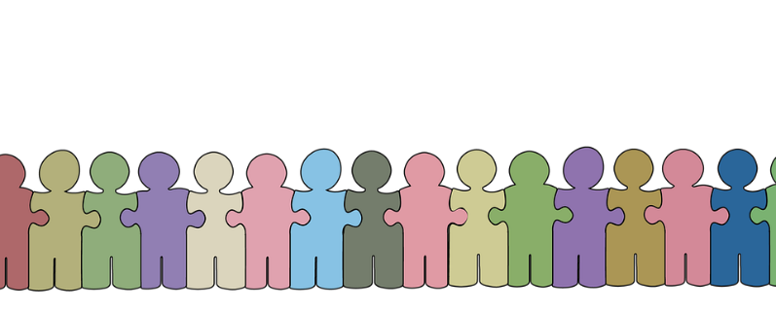
Plurilingual and pluricultural competence
Building on pluricultural repertoire
Understanding cultural values and differences
Sociolinguistic competence
Avoiding cultural misunderstandings
Dealing with cross-cultural communication
Pragmatic competence
Identifying cultural cues
Understanding how culture influences behaviour
FOSTERING OF SOCIAL COHESION

Slide 6
C levels: understanding cultural backgrounds by linking culture to beliefs, values and practices. Capacity to be sensitive to differences and react constructively and with cultural appropriateness
B levels: identifying cultural cues and acting accordingly, explaining and discussing cultural features. Recognising cultural misunderstandings and taking action in repairing them.
A levels: recognising cultural differences and identifying potential communication problems, acting appropriately in simple everyday exchanges.
C1: Can identify differences in sociolinguistic/-pragmatic conventions, critically reflect on them and adjust their
communication accordingly.
B2: Can, in an intercultural encounter, recognise that what one normally takes for granted in a particular
situation is not necessarily shared by others, and can react and express themselves appropriately.
A1: Can recognise differing ways of numbering, measuring distance, telling the time, etc. even though they
may have difficulty applying this in even simple everyday transactions of a concrete type.

Slide 7
Encouraging intercultural competence
“[…] the ‘intercultural dimension’ in language teaching aims to develop learners as intercultural speakers or mediators who are able to engage with complexity and multiple identities and to avoid the stereotyping which accompanies perceiving someone through a single identity.” (Byram et al., 2002: 9)
Language competence includes linguistic, sociolinguistic and pragmatic knowledge, as well as skills and existential competences. Cultural competence refers to these skills but to those relevant to specific social groups who speak a given language and their cultures.
Encouraging intercultural competence involves working with the learners on three pillars: their attitudes, their knowledge and understanding, and their skills. (Barret et al., 2014).

Slide 8
If you want to know more …
Barrett, M. D., Huber, J., & Reynolds, C. (2014). Developing intercultural competence through education. Strasbourg: Council of Europe Publishing.
Beacco, J., Byram, M., Cavalli, M., Coste, D., Cuenat, M. E., Goullier, F., & Panthier, J. (2016). Guide for the development and implementation of curricula for plurilingual and intercultural education. Strasbourg: Council of Europe. Language Policy Division.
Byram, M., Gribkova, B. and Starkey, H. (2002). Developing the Intercultural Dimension in Language Teaching: A practical introduction for teachers. Strasbourg: Council of Europe.
Cavalli, M., Coste, D., Crişan, A., & van de Ven, P. H. (2009). Plurilingual and intercultural education as a project. Languages in Education. Strasbourg: Council of Europe.
Council of Europe (2001). Common European Framework of Reference for Languages: Learning, Teaching, Assessment. Cambridge: Cambridge University Press.
Council of Europe (2011). European Language Portfolio: Principles and Guidelines. Strasbourg: Council of Europe. (Available at www.coe.int/portfolio)
Council of Europe (2020). Common European Framework of Reference for Languages: Learning, Teaching, Assessment. Companion volume. Strasbourg: Council of Europe.
Fleming, M., and Little, D. (2010). Languages in and for Education: a role for portfolio approaches? Strasbourg: Council of Europe. (Available at www.coe.int/lang → NEWS → INTERGOVERNMENTAL FORUM → PROGRAMME AND DOCUMENTS)

